Slide 1

Bias in Clinical Research
Yasser Albogami, MPH, Ph.D.
PHRM 414
(Lab)

Slide 2
Confounding Exercises

Slide 3
Confounding in pharmacoepidemiology
The way drugs are being prescribed introduces bias in observational studies which is referred to as confounding by indication.
Physicians prescribe SSRI to treat depression. Can we compare SSRI users and non-users to evaluate suicide risk? Why?

Slide 4
Confounding in pharmacoepidemiology
The way drugs are being prescribed introduces bias in observational studies which is referred to as confounding by indication.
Physicians prescribe SSRI to treat depression. Can we compare SSRI users and non-users to evaluate suicide risk? Why?
Depression
SSRI use
Suicide Risk

Slide 5
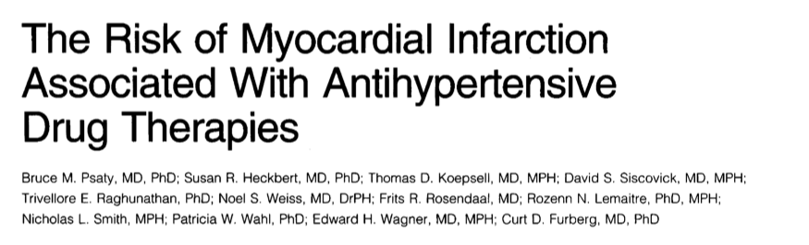
Confounding Exercises
Read the article and:
1- What is the research question?
2- What is the main finding?
What do you think of the results?
Notes:
1- does antihypertensive drugs increase the risk of MI?
2- There was an increase risk of MI among CCB users
3- there is confounding by indication. Patients who used CCBs had severe hypertension compared to others and severe hypertension increases the risk of MI

Slide 6
Bias Exercises

Slide 7
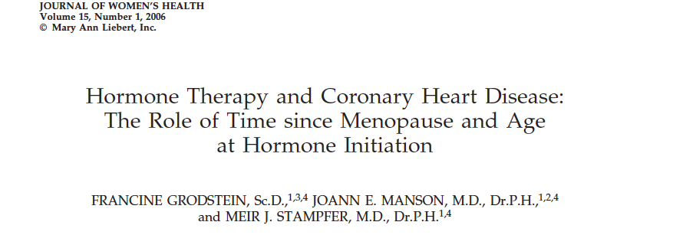
Prevalent User Bias
In 2006, researchers conducted an observational study and found that postmenopausal hormone therapy significantly reduced coronary heart disease about 30% compared to postmenopausal women who never used hormone therapy.
  These results contradicted previous findings from an RCT that showed initiating hormone therapy increases the risk of CHD by 20% among postmenopausal women!! (Manson et al. NEJM, 2003)

Slide 8
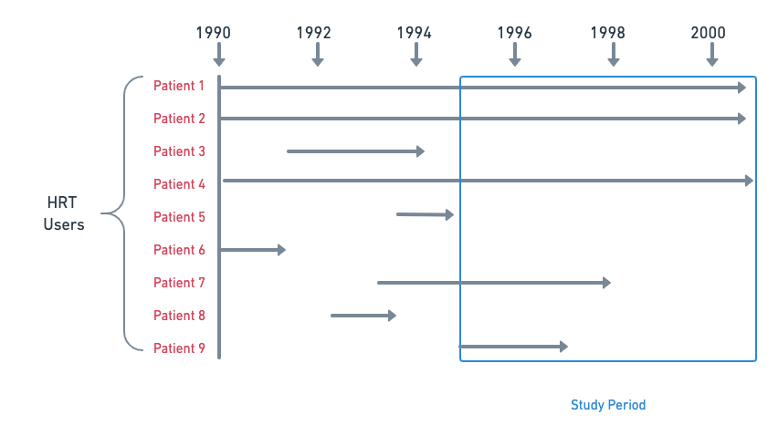
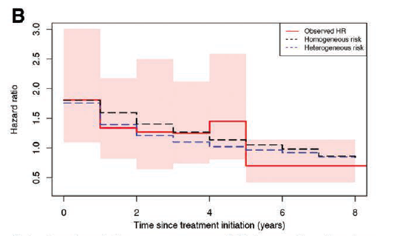
Prevalent User Bias
Researchers assumed the CHD risk is constant during HRT exposure
Stensrud et al., Epidemiology, 2017

Slide 9
Prevalent User Bias
In 2008, the same data were re-analyzed to explain the discrepancies between RCTs and RWE findings.
The researchers emulated an RCT by only including HRT initiators (new users). The only two differences between the RCT and the new re-analysis are:
  1- No randomization ad 2- No placebo assignment
 | RCT (Women Health Initiative) | Observational data (Nurses’ Health Study)
Overall (HR (95%CI)) | 1.23 (0.99 – 1.53) | 1.05 (0.82 – 1.34)
Stratified by years of follow-up
0 – 2 years (HR (95%CI)) | 1.51 (1.06 – 2.14) | 1.43 (0.92 – 2.23)
> 2 years (HR (95%CI)) | 1.07 (0.81 – 1.41) | 0.91 (0.72 – 1.16)
Hernán et al. Epidemiology. 2008;19(6):766-779. doi:10.1097/EDE.0b013e3181875e61

Slide 10
Immeasurable Time Bias

Slide 11
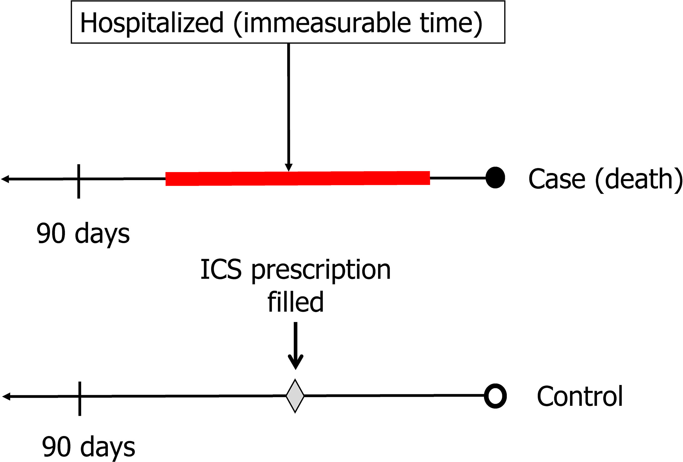
Immeasurable time bias
It refers to a period of time during follow-up, during which a subject cannot be recognized as being exposed.
For example, we would like to evaluate the association between inhaled corticosteroids and death in a case-control study. However, we have only outpatients data, which means patients admission data are not available.

Slide 12
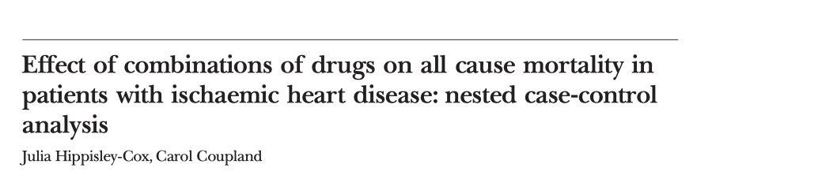
Immeasurable time bias
Read the article and:
1- What is the research question?
2- What is the main finding?
What do you think of the results?
Notes:
1- do the drugs included in the study increase the CHF?
2- most drugs assessed decreased the risk of CHF
3- There was immeasurable time bias. Patients were at risk of readmission during which the researchers could not know whether they used the drugs included in the study which underestimated the rsik estimated.

Slide 13
Assignments

